Slide 1
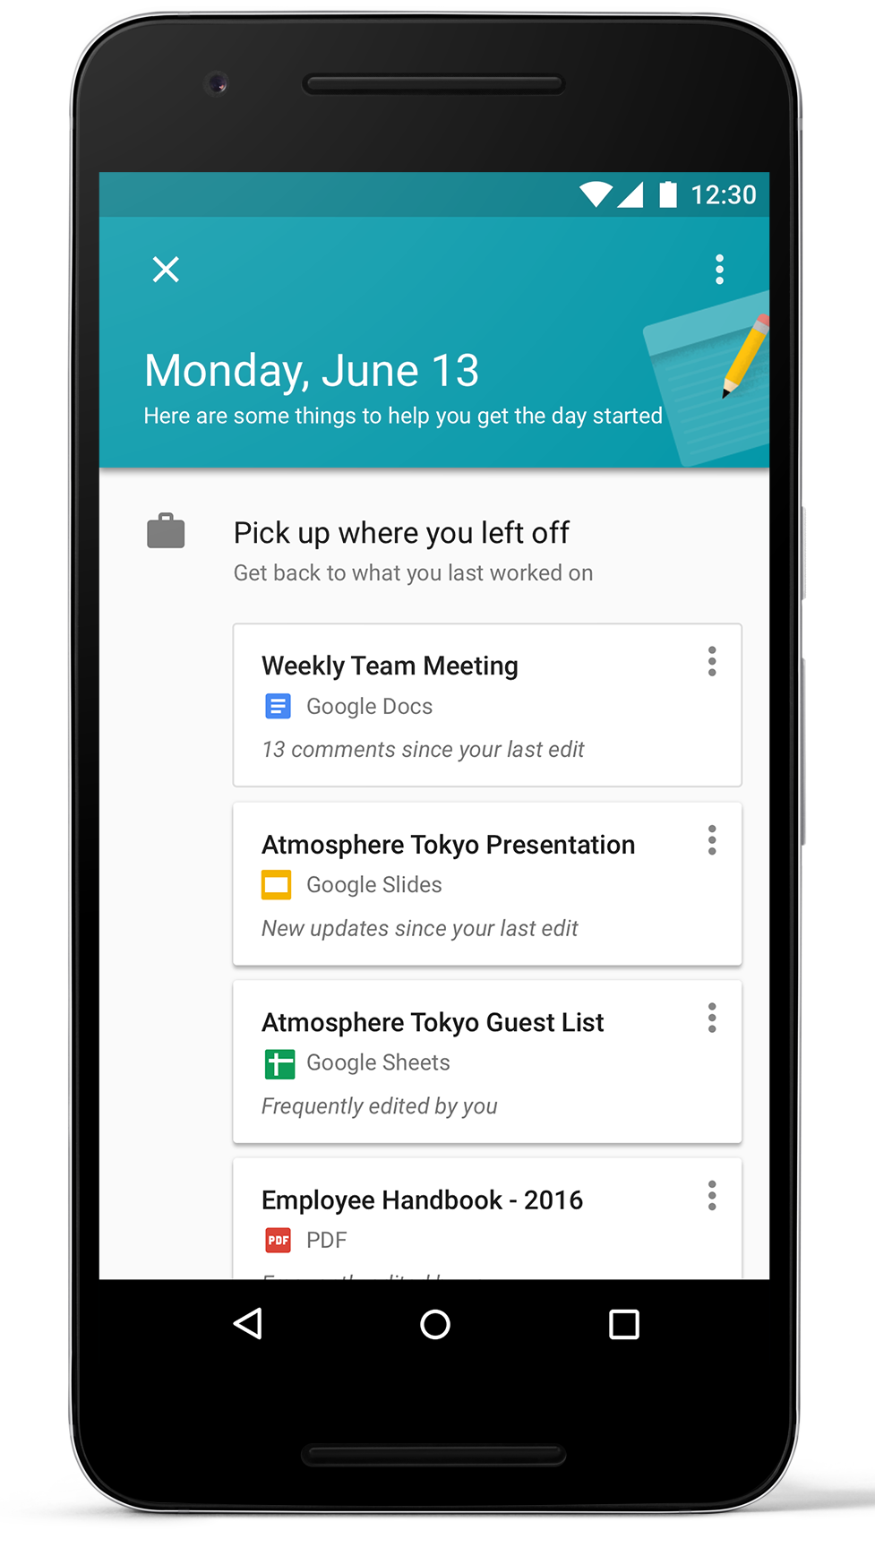
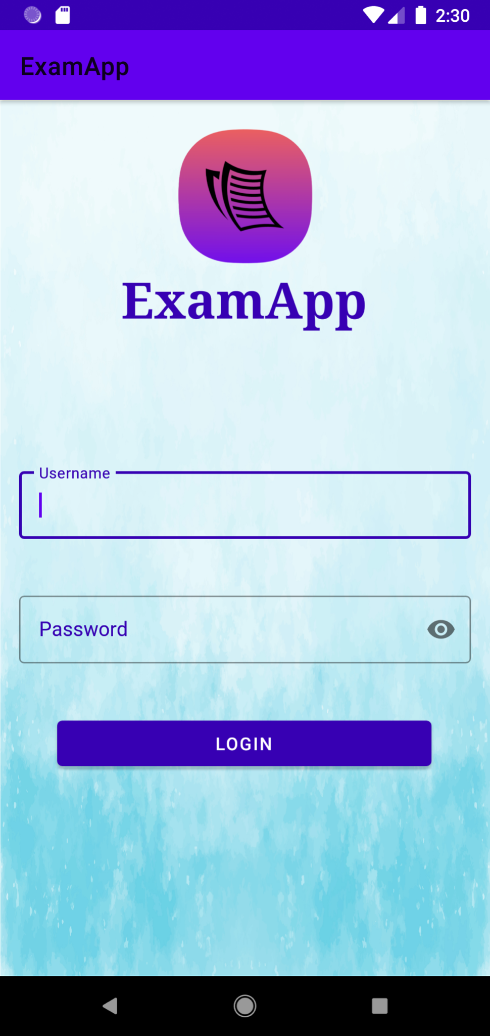
Exam App

Slide 2
Summary
01
Introduction
02
The Customer
03
The Product
04
Architecture & Algorithms
05
Communication Links
06
Hardware

Slide 3
01
Introduction

Slide 4
Introduction
Designed for academic institutions.
Mobile android application to sign-in students to their exams.
Main features include:
Student sign-in.
Automatic seat number assignment.
Student sign-out.
Used by invigilators and professors during an exam.
Portable setup and easy to use application.
Status reports for invigilators and professors.

Slide 5
02
The Customer

Slide 6








Target Customers : Academic Institutions
Value : Secure Biometric/Analog Exam Taker Verification System
What Our Product Offers :
Facial Recognition
Card Scanning
Manual ID Verification
Seat Generation & Assignment
Exam Hall Report Generation
Notes:
Our product targets academic institutions that conduct in-person examination and requires mandatory verification of the student’s identity prior to taking the exam.
Academic Institutions that conduct in-person examinations currently rely on manually verifying an exam taker’s identity by checking their student ID card, then looking at the image associated with the ID to verify that the exam taker is the same person associated with the image which is a process prone to human errors. In addition once the person is verified the seats are randomly assigned to the students and manually inputted into an examination roster. Although this process may be viable for small examinations, it is not the most secure nor the most efficient model for final examinations or institution-hosted examinations such as MCATs, GMATs, LSATs etc.
Therefore we created an application that verifies an exam taker’s identity using an artificially intelligent biometric facial recognition model to eliminate human errors associated with manual verification. Once the person is verified, they will automatically be assigned a random seat and a report will be automatically generated which can be accessed by users who have administrative privileges such as Invigilators and Professors. The application also offers other verification solutions such as using student ID scanning or manual ID verification.

Slide 7


Customer Value
 | Traditional Invigilation | ExamApp Invigilation
Data Security
Record Organization
Data Persistence
Easy Information Retrieval
Error Reduction
Multiple Verification Methods

Slide 8
03
The Product

Slide 9
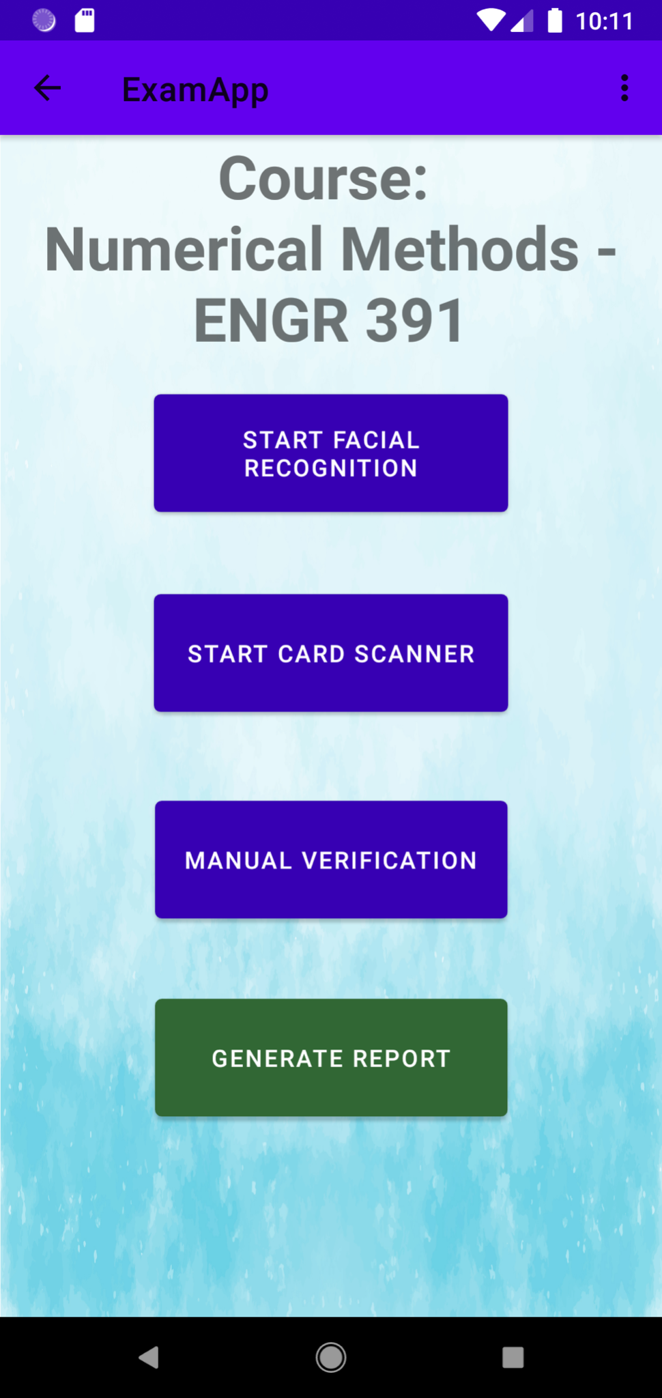
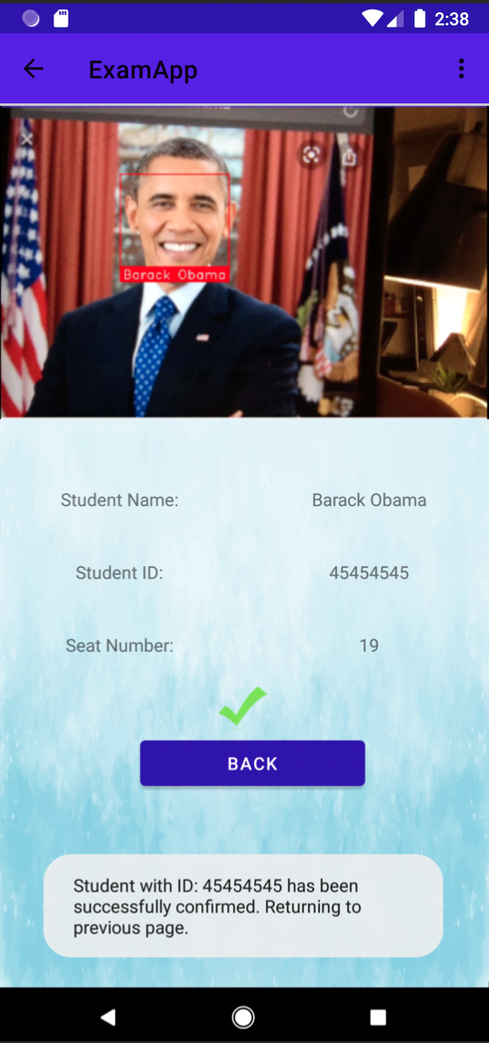
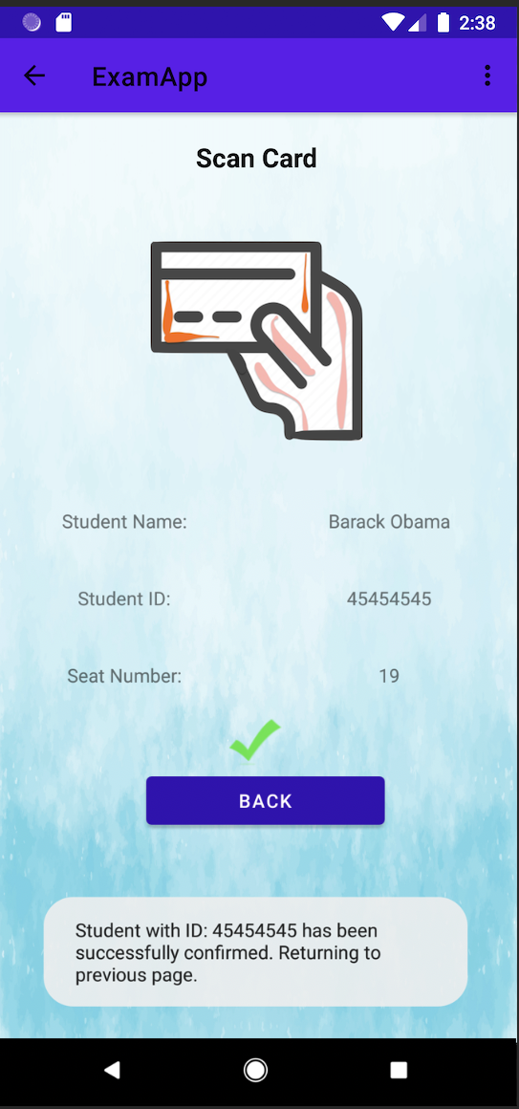
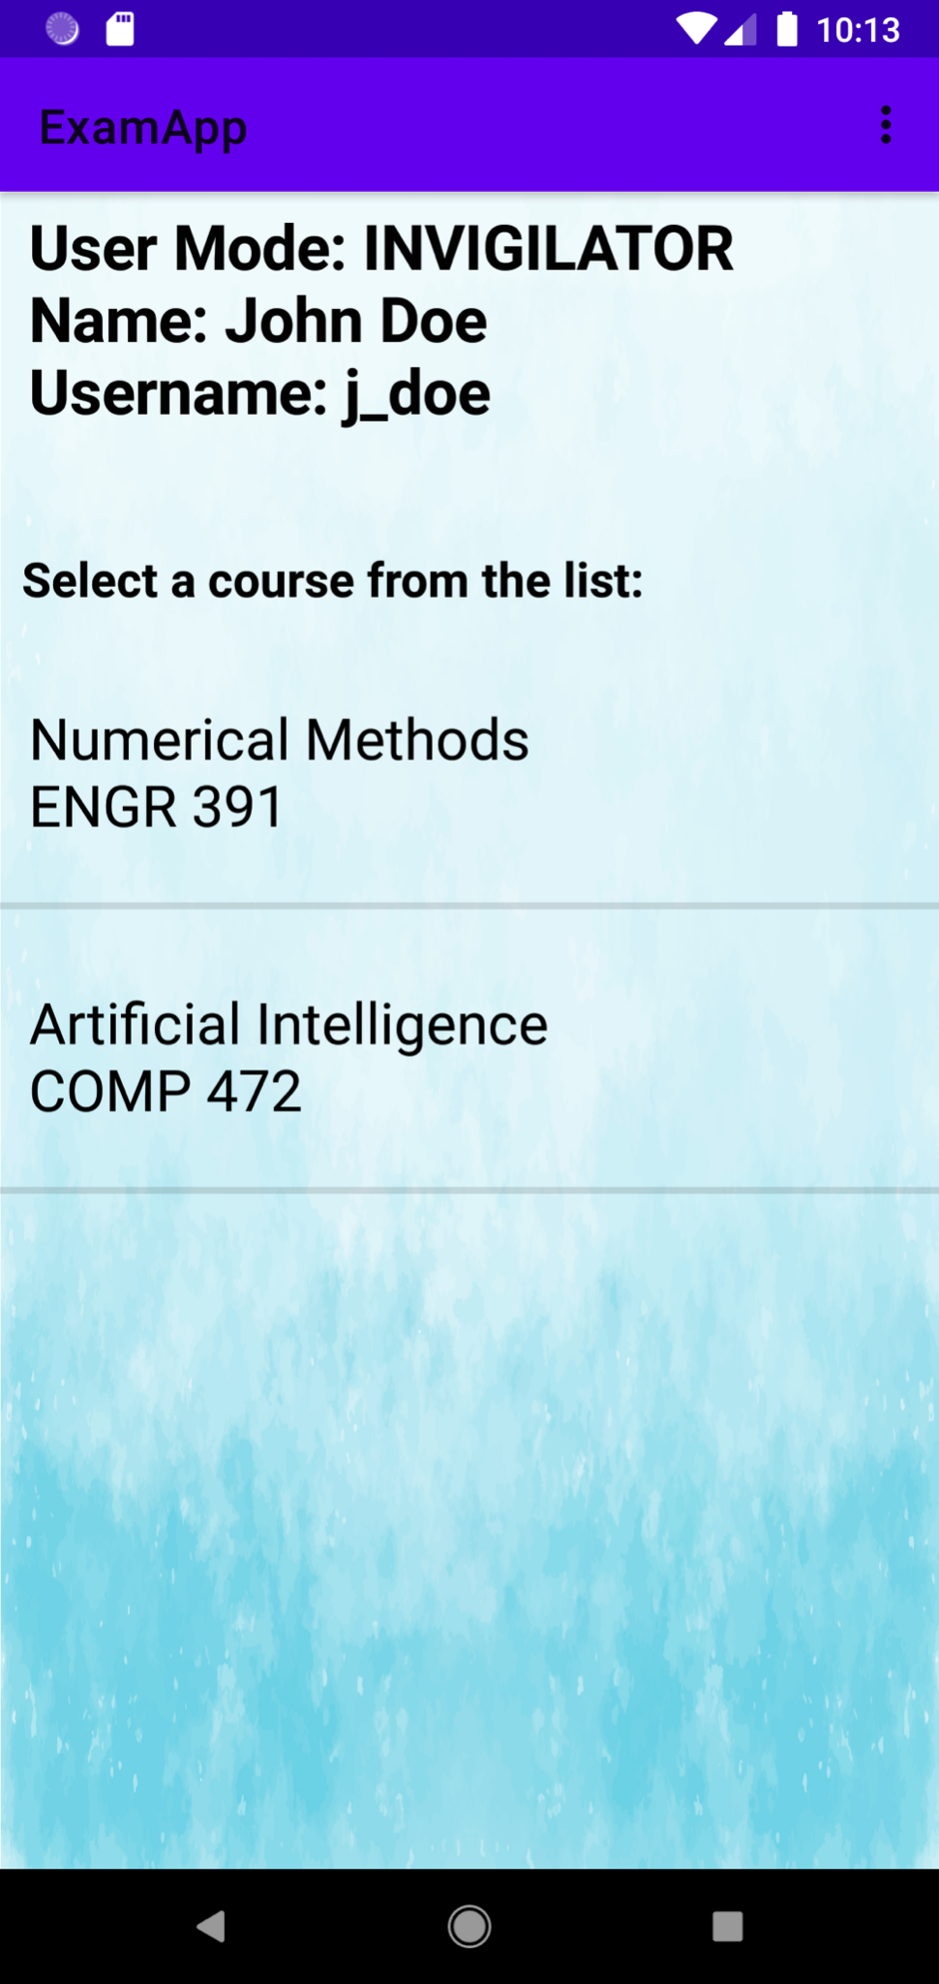
Product Tour - Invigilator
98%
Course Selection
Invigilator Verification Options
Facial Recognition Verification
Card Scan Verification

Slide 10
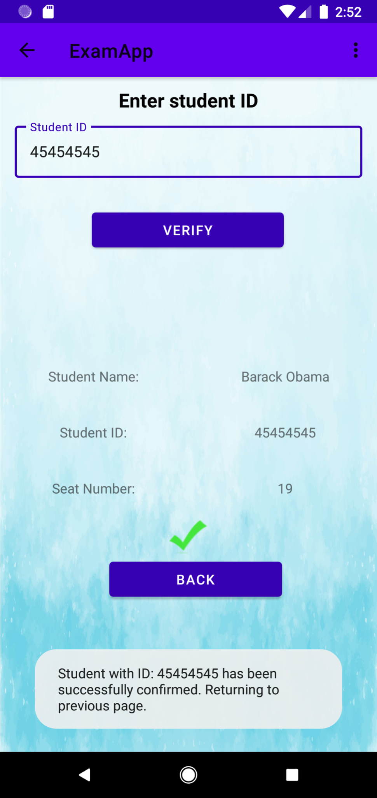
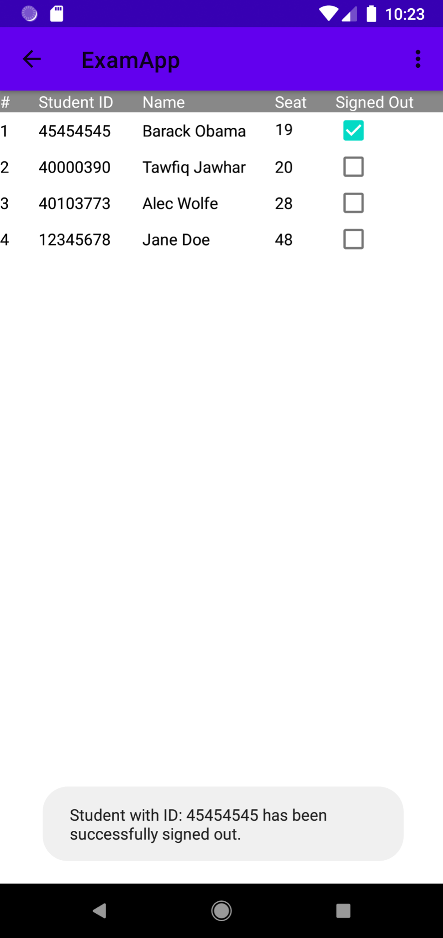
Product Tour - Invigilator
Manual Verification
Invigilator Report

Slide 11
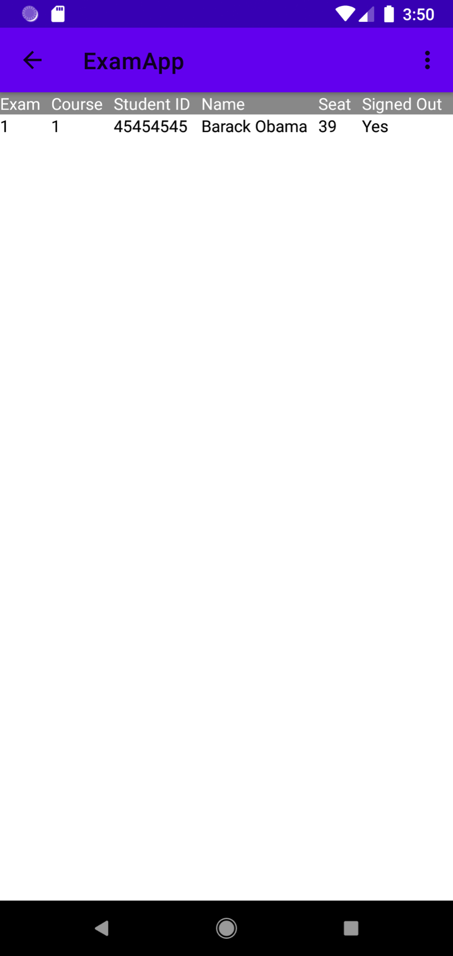
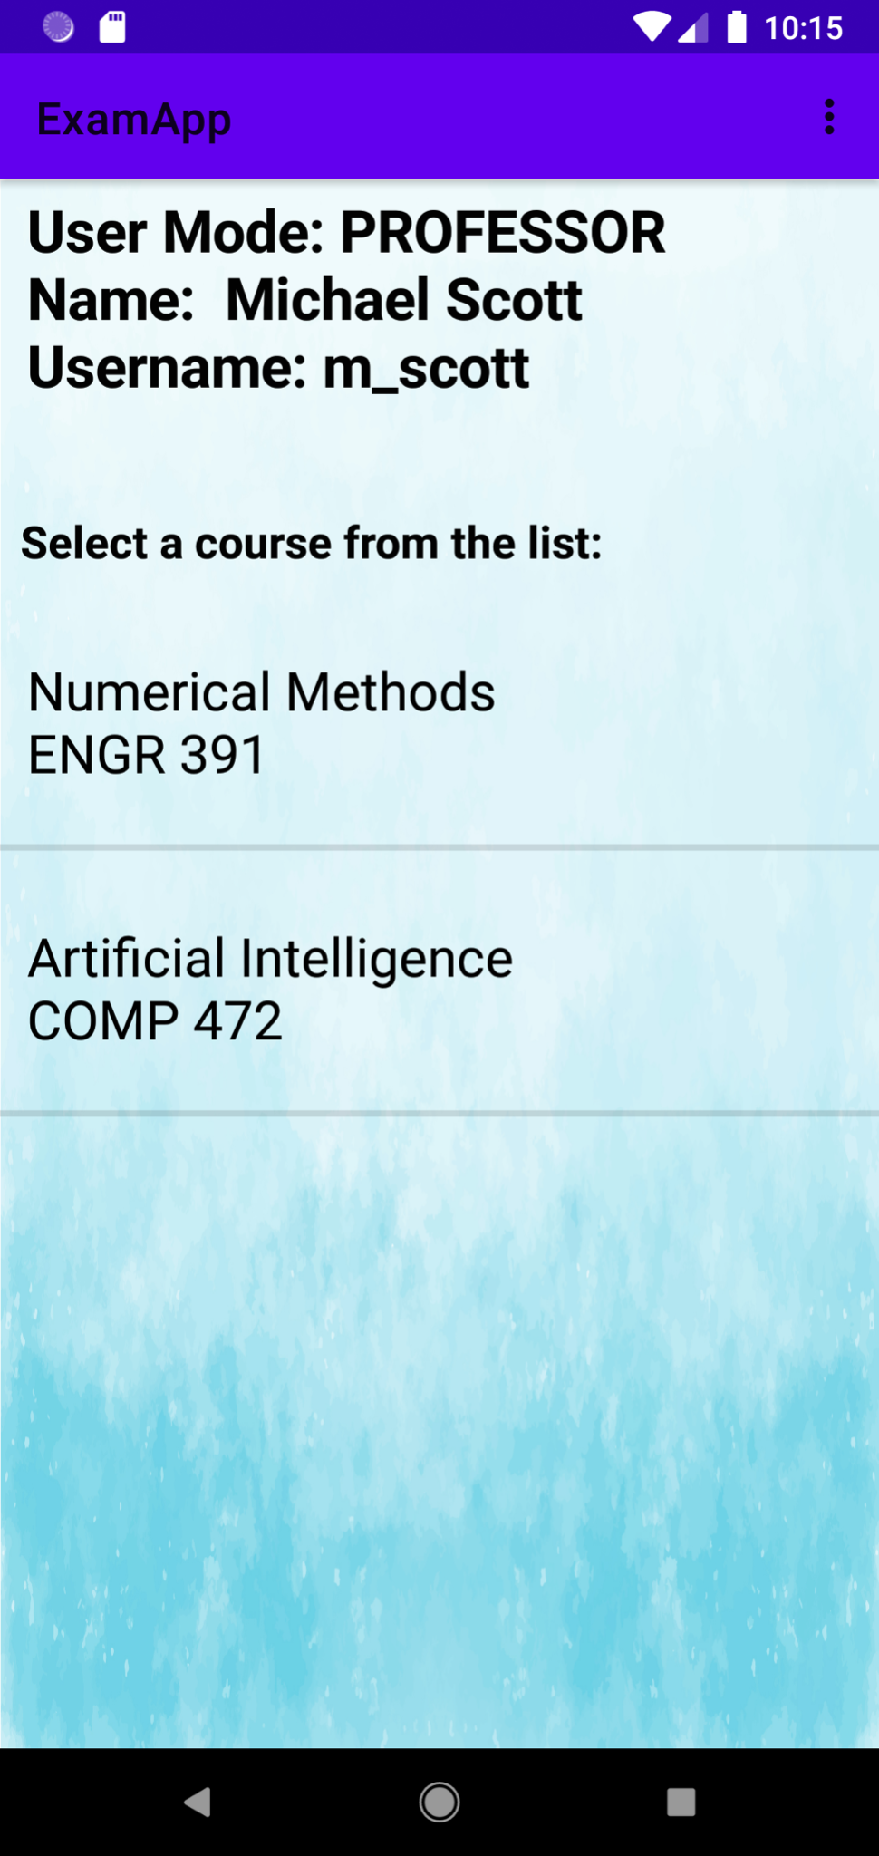
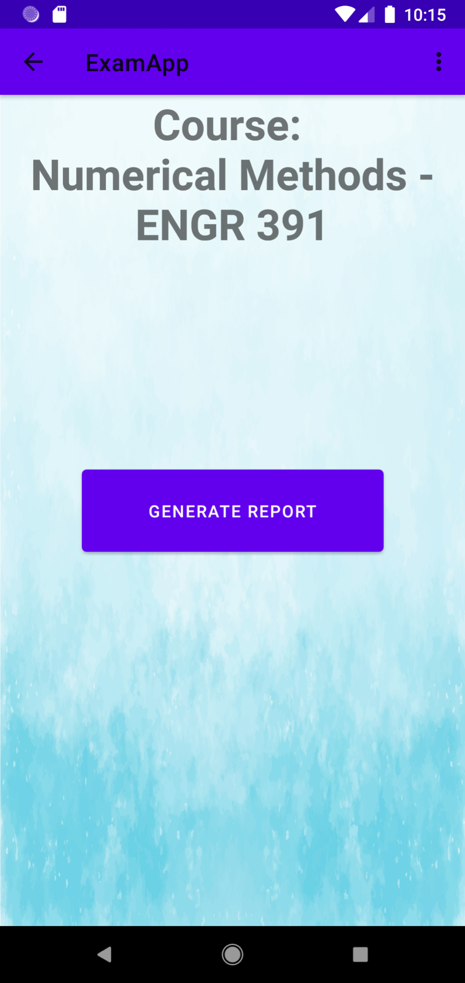
Product Tour - Professor
Course Selection
Generate Report Option
Professor Report

Slide 12
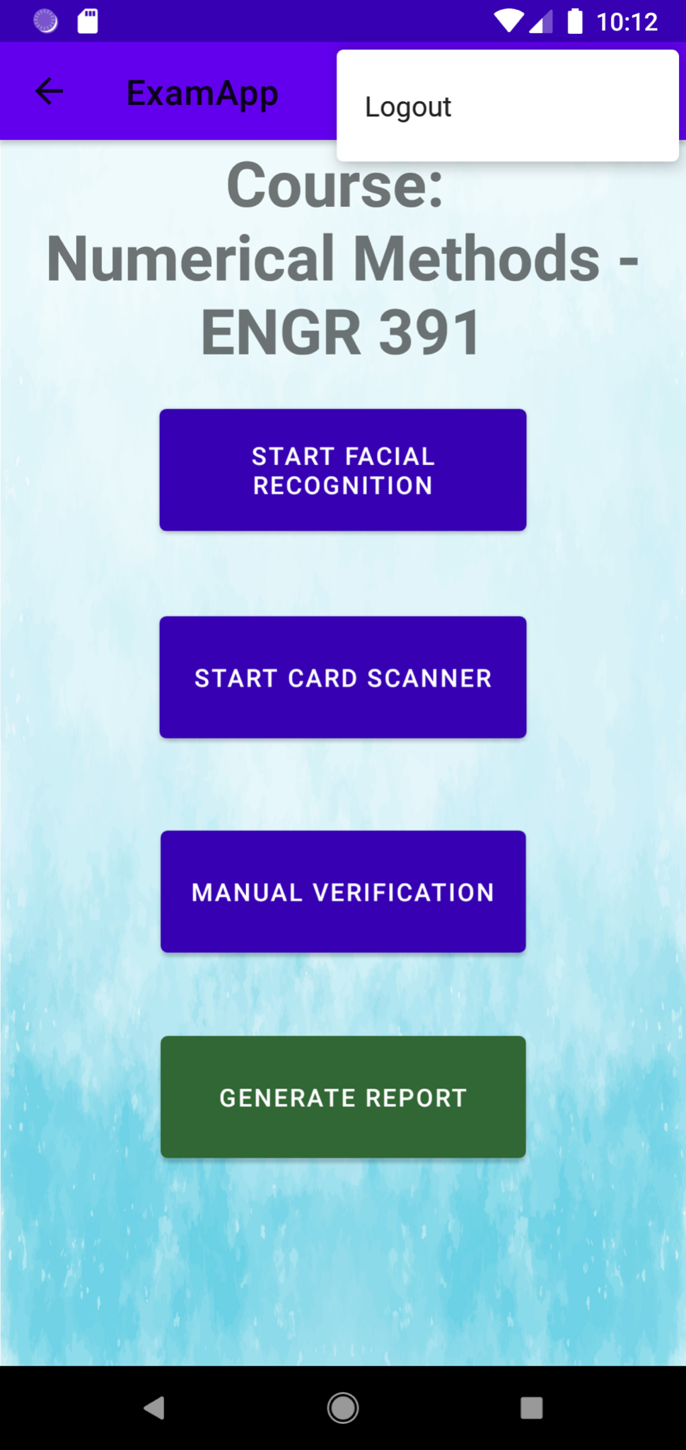
Features
Logout
The user will be free to logout from their account at their convenience
Back Navigation
The user will be able to move backwards through the history of screens they previously visited.
Notes:
Paulina:

Slide 13

Invigilator
Professor
Displaying Name and Username
Choose a course
The user will have to choose their specific course
Choose method for student verification
The user will have to choose from three available methods to verify the student’s identity
Generate Report
Notes:
Paulina

Slide 14
Facial Recognition
Facial Recognition
The student will be recognized via their facial features and the screen will display a confidence level percentage as well as the student ID number
Student Name
After a successful recognition, the student’s name will be displayed.
98%
Student ID
After a successful recognition, the student’s id will be displayed.
Seat Assignment
A seat number will be assigned to the student
Check-Mark or X-Mark
If the student is enrolled in the class and he/she is successfully recognized, a check-mark will be displayed. Otherwise, an x-marked will be shown
Confirmation
The user will receive visual confirmation when the recognition/verification procedure is successful
Notes:
Paulina

Slide 15
Scan Card
Student Name
After a successful recognition, the student’s name will be displayed.
Student ID
After a successful recognition, the student’s id will be displayed.
Seat Assignment
A seat number will be assigned to the student
Check-Mark or X-Mark
If the student is enrolled in the class and he/she is successfully recognized, a check-mark will be displayed. Otherwise, an x-marked will be shown
Confirmation
The user will receive visual confirmation when the recognition/verification procedure is successful
Notes:
Paulina

Slide 16
Manual Verification
Manual Input of Student ID
The student will be recognized via his/her student ID
Student Name
After a successful recognition, the student’s name will be displayed.
Student ID
After a successful recognition, the student’s id will be displayed.
Seat Assignment
A seat number will be assigned to the student
Check-Mark or X-Mark
If the student is enrolled in the class and he/she is successfully recognized, a check-mark will be displayed. Otherwise, an x-marked will be shown
Confirmation
The user will receive visual confirmation when the recognition/verification procedure is successful
Notes:
Megan.
-As an added layer of verification the app features a manual entry page where the invigilator can enter the student ID number and click on verify to check whether the student is registered in the course.
-The manual verification contains all the same features as facial recognition and card scan.
-It displays the name, and id of the student and assigns a seat number. It also has the check mark or x-mark display to show if a student is in the course or not.

Slide 17
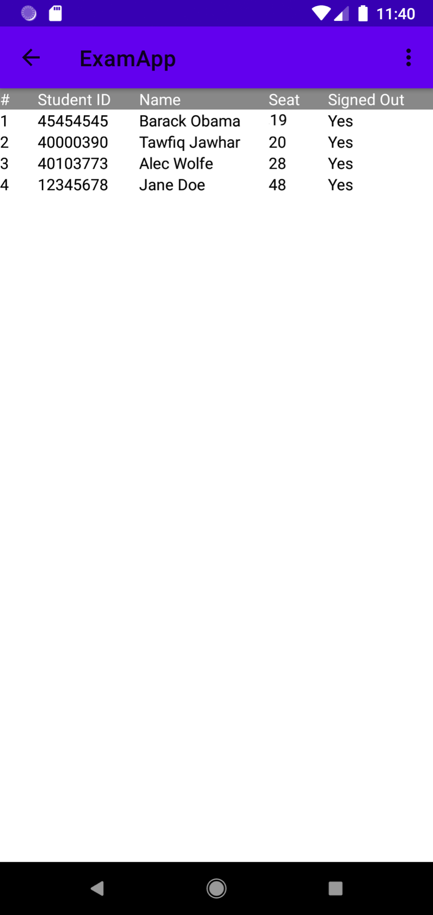
Report
Invigilator
Professor
Complete Report
The professor will have access to their
corresponding examination attendance report
Student Signed Out
Once a student has completed the exam, the invigilator will be able to signed him/her out of the examination.
Confirmation
The user will receive visual confirmation that the signing out procedure was successful.
Notes:
Megan
-The report feature, displays a log of the exam registration. It displays the student name and ID of the students who have been registered. It also shows their seat number.
-For the invigilator, this is also where the student sign out takes place. The invigilator can select the checkbox next to the student that is signing out.
-A confirmation message will be displayed that the sign out was successful.
-In the professor’s report, they will be able to see which students have signed out of the exam.

Slide 18
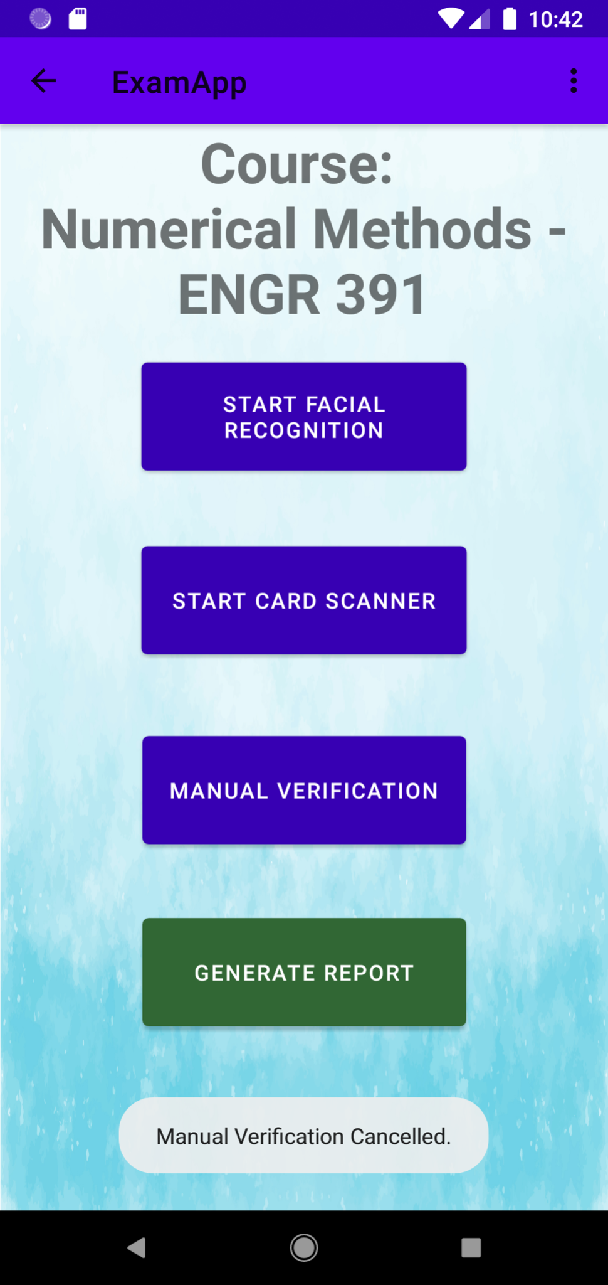
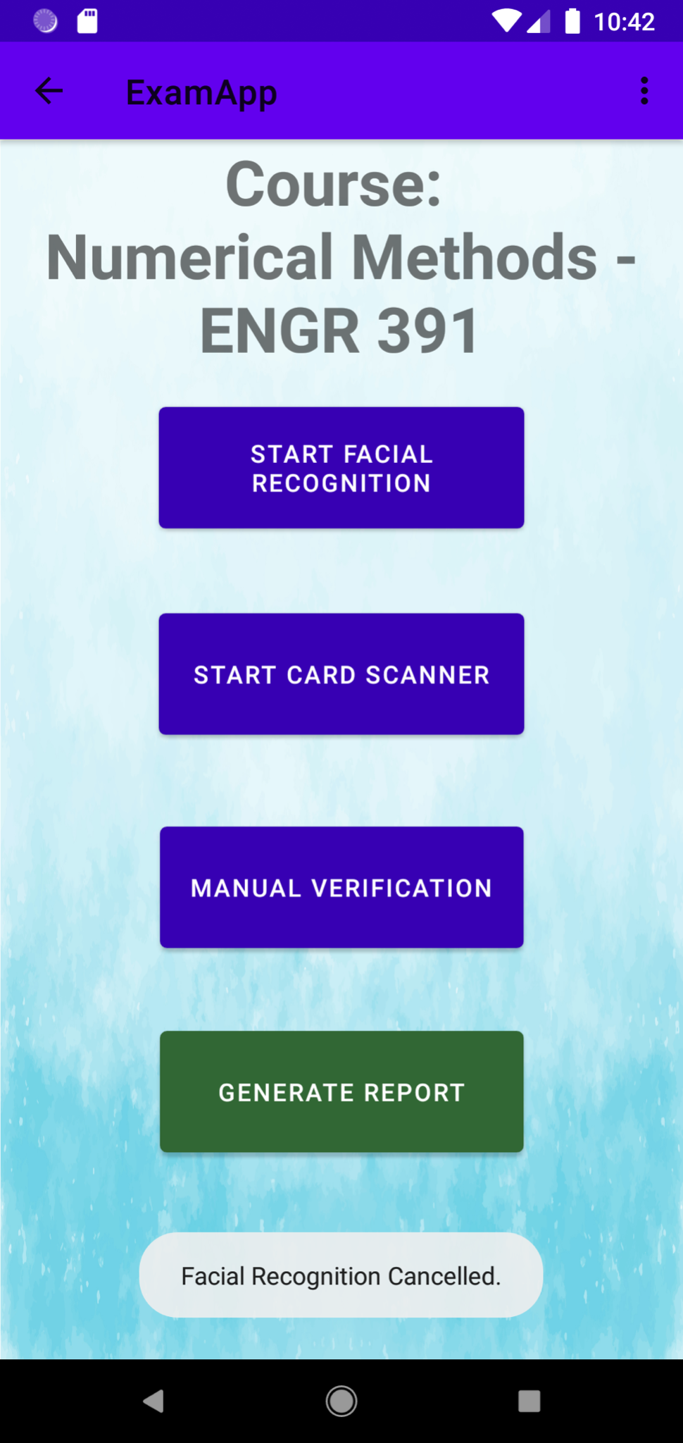
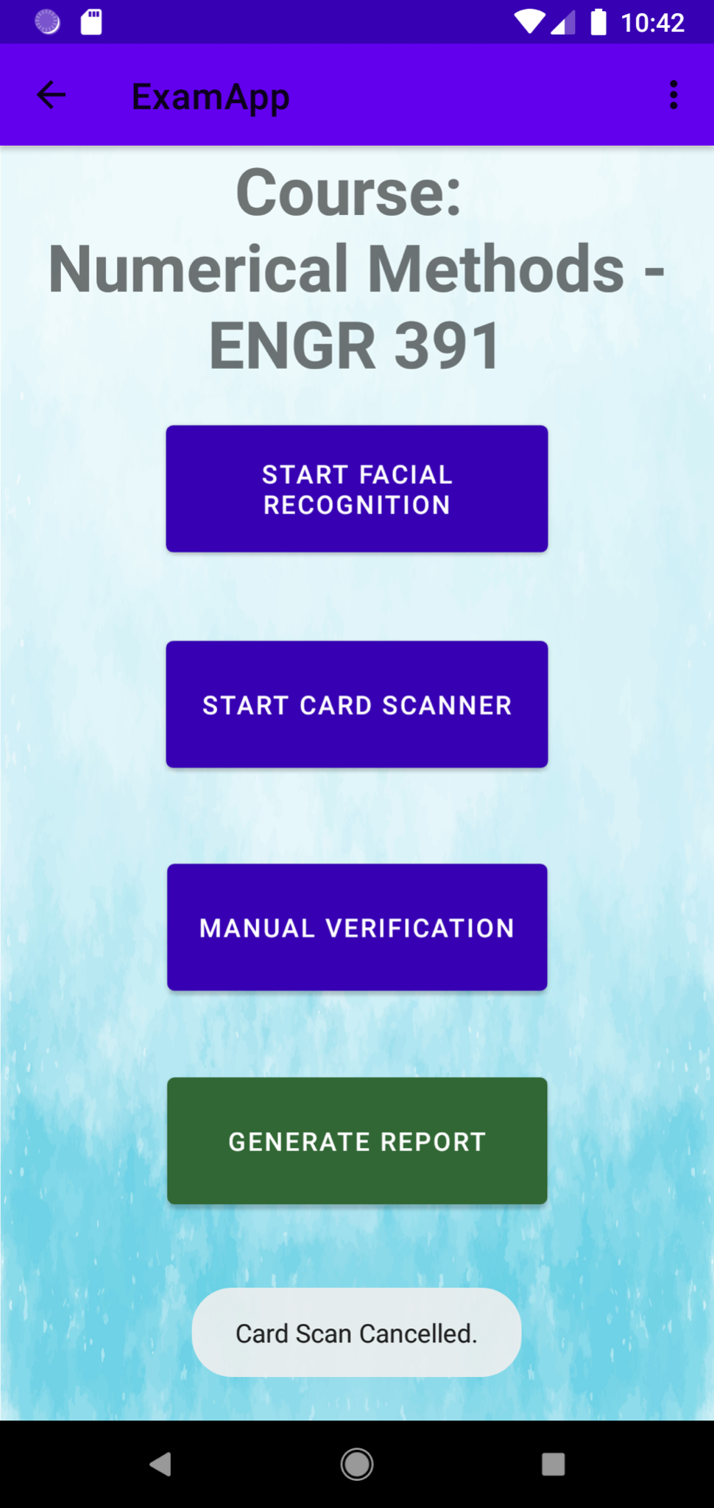
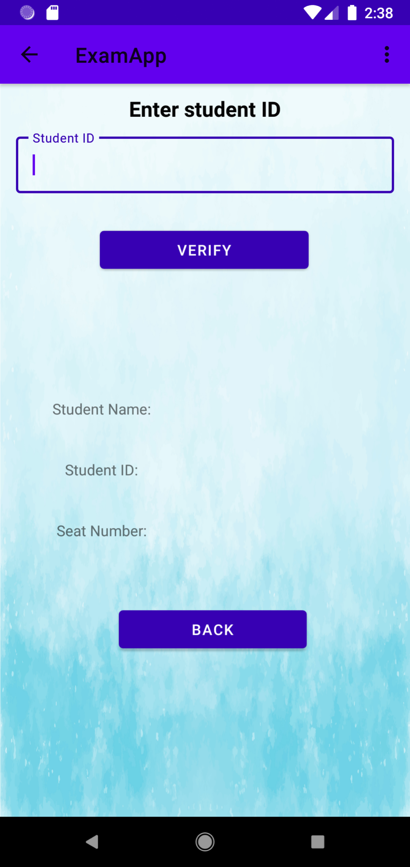
Cancellation
Cancelling a Method
The user will receive visual confirmation when the back button of a verification method is pressed.
Notes:
Megan
-After selecting a verification method if the invigilator wishes to cancel and return to the previous page, they can select the BACK button. They will be returned to the selection activity and receive a message confirming the cancellation.

Slide 19
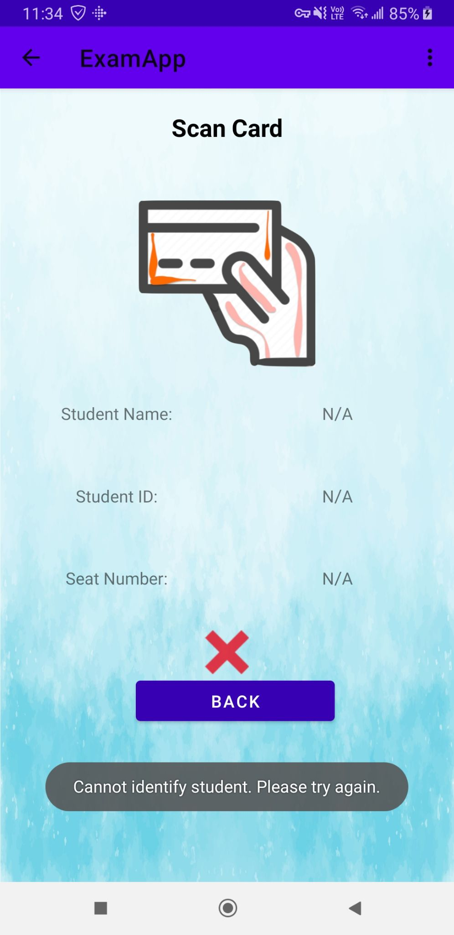
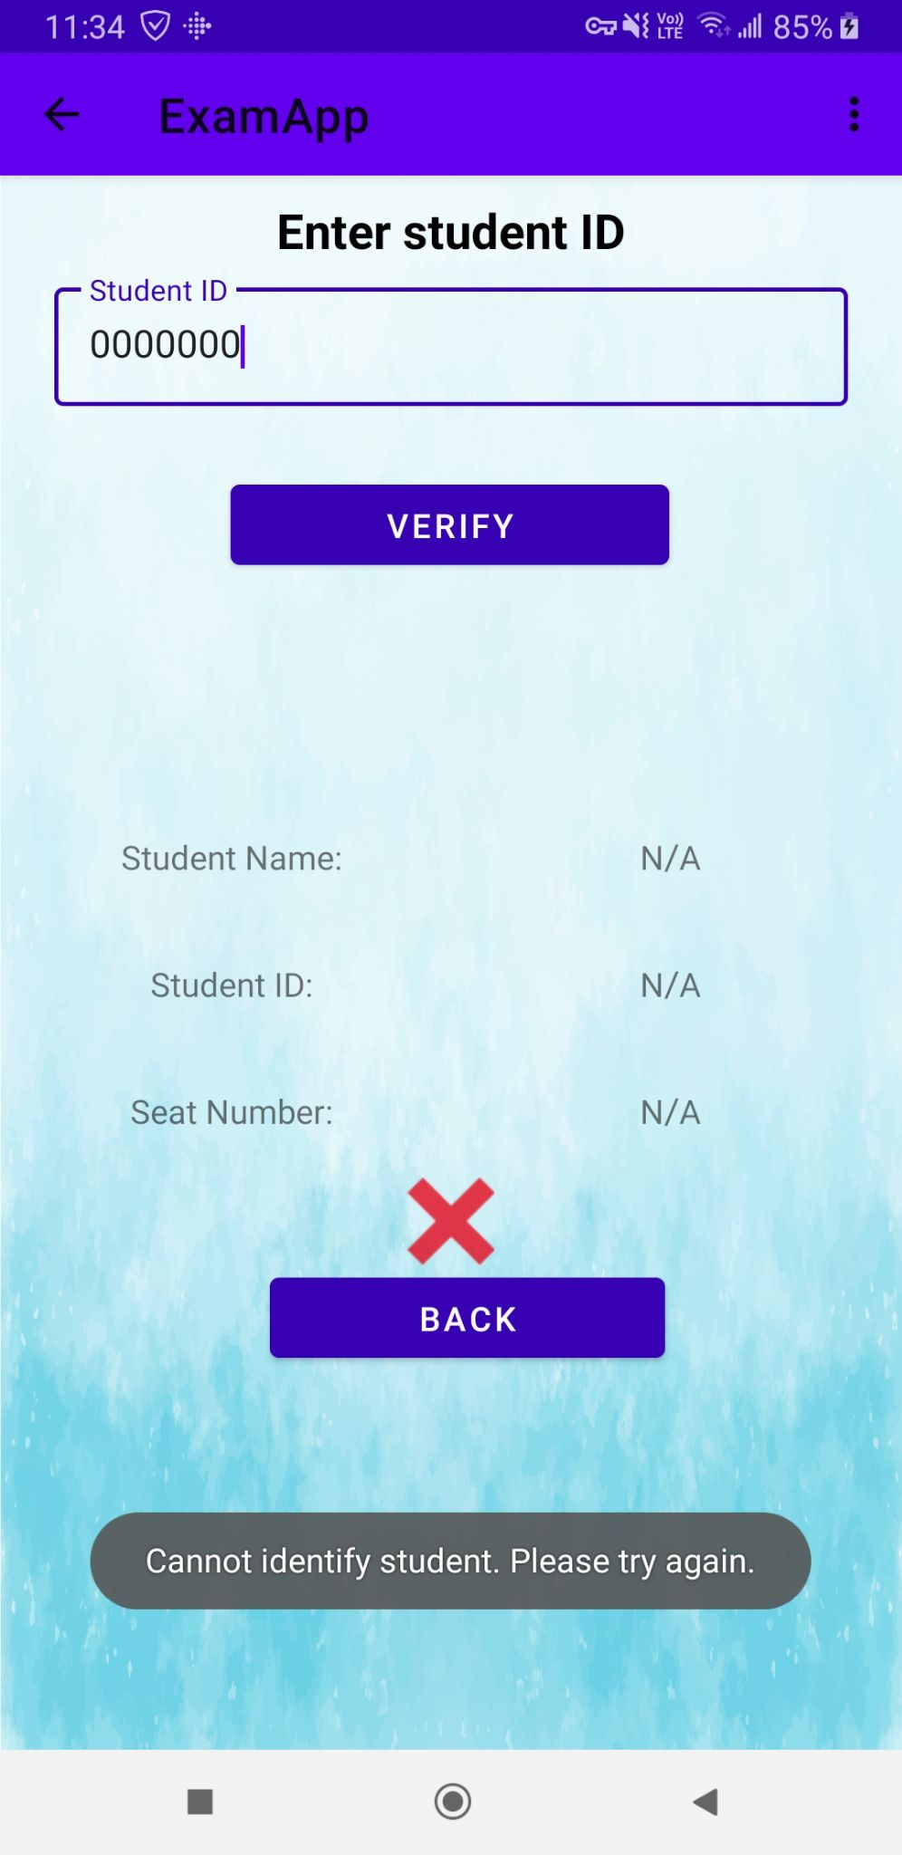
Invalid Student
Incorrectly recognizing a student
The user will receive visual confirmation when the student does not belong in the exam, or if there is an issue with the card or face scanner. This will allow the invigilator to try a different verification method.
An ‘X’ mark to display failed verification
A persistent message prompting to restart the verification
Notes:
Megan
-If the student signing in is in the wrong exam room and is not registered for the selected course then a red X mark will be shown and no student information is displayed.
-In the facial recognition or card scan activity, if there is an issue with the scan and the student is not identified then the x-mark will appear and the student information will not be displayed.
-A message will be shown to prompt the invigilator to try another verification method in case of an issue the scan or the student does not belong in that exam.

Slide 20
04
Architecture & Algorithms

Slide 21


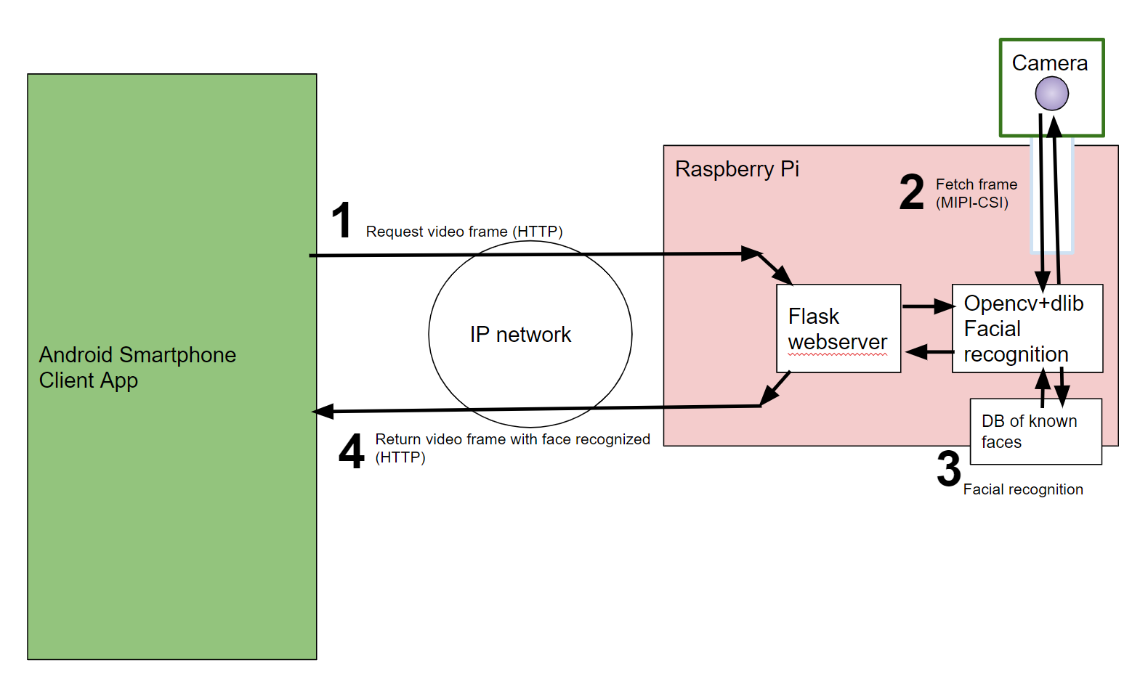
Architecture
(Facial Recognition)
Notes:
Ahmed -
The system architecture of the facial recognition feature is fairly simple. The smartphone client app communicates with the Pi server app over an IP network where the client sends an HTTP request to recognize a person.
The server directly obtains the video frame from a Pi camera which gets processed using a facial recognition module and recognizes a person based on encodings of a Database of registered students. The results are then returned back to the Android app to be verified and stored.

Slide 22
Facial Recognition
pre-generated encodings of students data
Server-Side (Raspberry PI + PI Camera)
Load face information from encodings
Acquire Video Feed from PI Camera
Grab a single frame from feed & process every other frame to improve speed
Facial recognition model verifies acquired face against known student info encodings
Facial recognition model returns verified face info based on confidence and threshold levels
Client Request
Server Return
Notes:
Going more into depth on the algorithm of the facial recognition process, after receiving the client’s request to verify a student, The server side will load the required face information from the encodings and acquires a video feed from the PI camera. The facial recognition module will grab a single frame from the video feed and & process every other frame to improve speed. The frames are then verified against existing student’s info and based on the model’s confidence and threshold levels then the server returns an object of the verified person

Slide 23
Client Request
Server Return
Client - Side (Android App)
HTTP Request to recognize Student’s Identity
Receive recognized student info and verify against current examination roster
Assign random seat to student
Update Examination Roster
View Results to User (Invigilator)
Notes:
once the information is released from the server side, it gets processed by the android app to verify the recognized student against the current examination roster and assign a random seat to the student. The information can be displayed through the invigilator or professor’s reports. Next, Alec will be speaking more about the card scanning architecture and algorithms

Slide 24
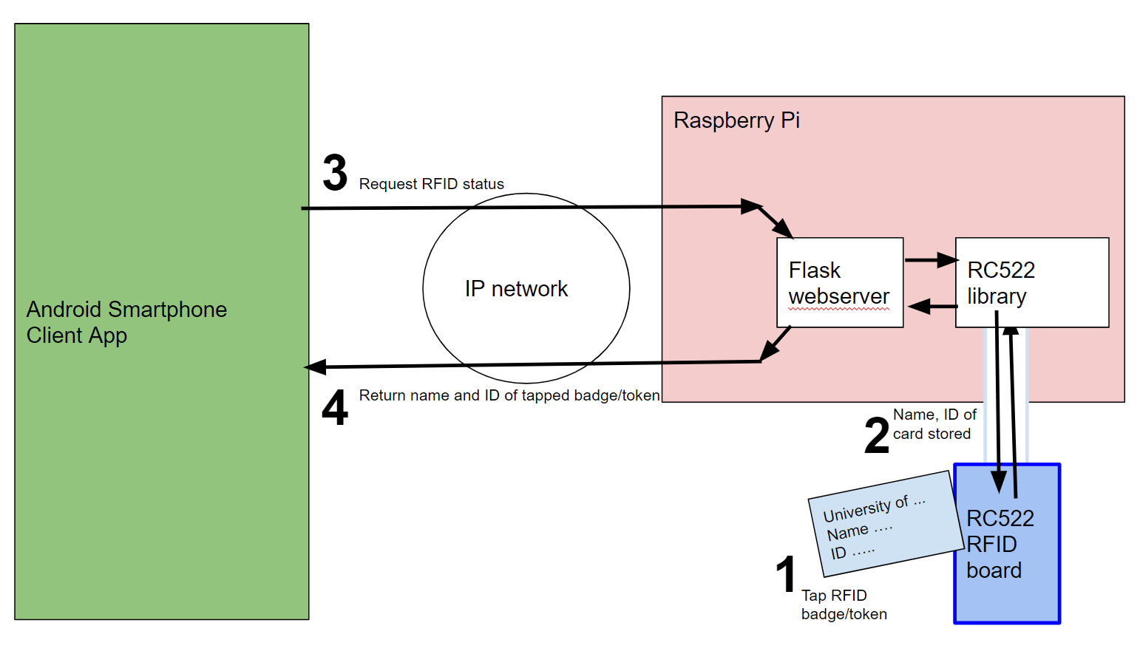
Architecture
(Card Scanner)
Notes:
alec

Slide 25
Card Scanning
Server-Side (Raspberry Pi + Card Scanner)
Continuous communication with RC522 RFID scanner board
Check if RFID card has recently been scanned
Return scanned user or ‘noscan’ status
Client Request
Server Return
Notes:
alec

Slide 26
Client Request
Server Return
Client - Side (Android App)
HTTP Request to get student info from RFID card
Receive scanned student info and verify against current examination roster
Assign random seat to student
Update Examination Roster
View Results to User (Invigilator)
Notes:
alec
card scanning client side

Slide 27
05
Communication Links

Slide 28


Communication Links
IP network (wifi, ethernet, etc)
HTTP multipart video feed
JSON over HTTP for recognized face, tapped card information
Card scanner accessed over SPI
Notes:
alec

Slide 29
06
Hardware

Slide 30
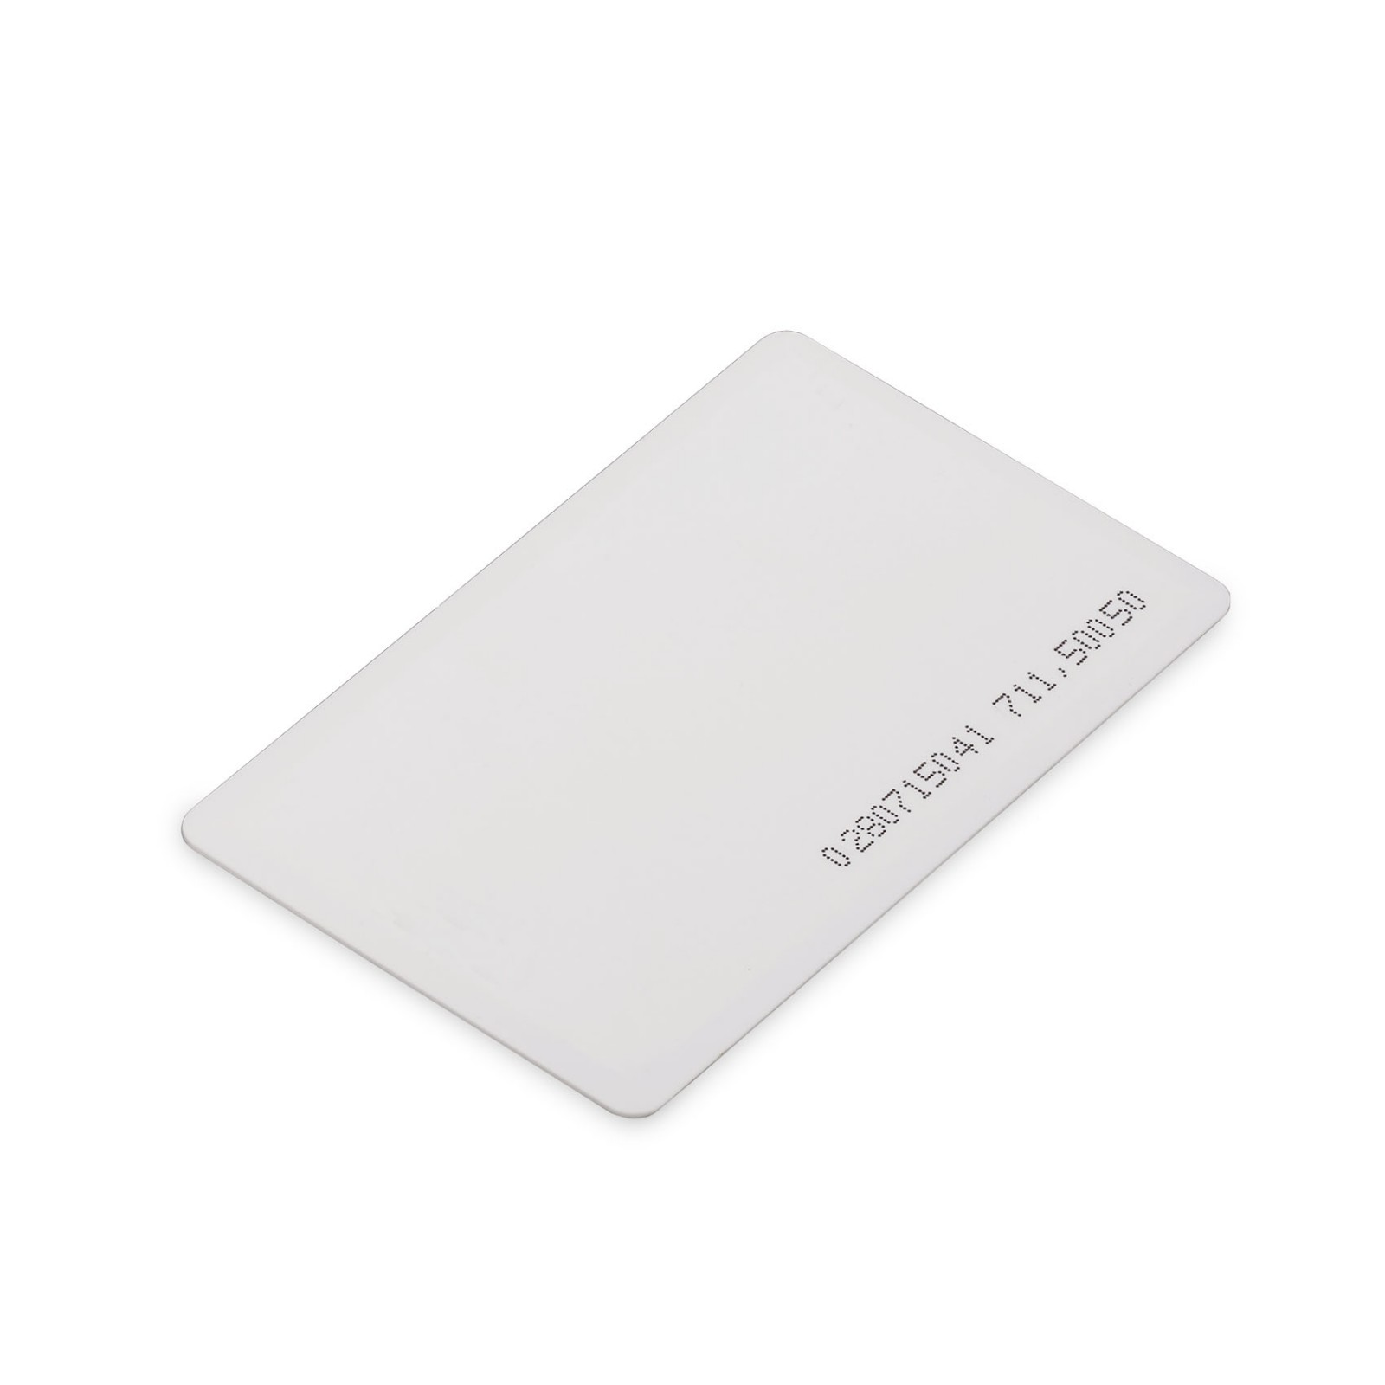
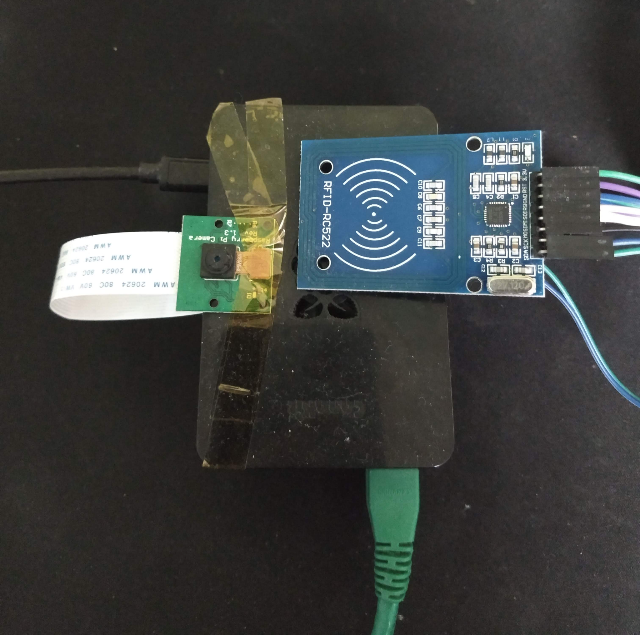
Hardware
RFID Cards
RFID Sensor
Raspberry Pi Camera
Raspberry Pi 4
Notes:
alec
RPi 4, Pi camera, RC522 RFID sensor

Slide 31
THANK YOU

